Slide 1
BCS 2107: DATABASE SYSTEMS I GROUP III PROJECT
BSCNRB587922
BSCNRB126523
BSCNRB129923

Slide 2
INTRODUCTION
Good afternoon, everyone. Group III, are here to share our database project with you today. In the next few minutes, we'll take you on a journey through our collaborative efforts and the outcomes we've achieved. The objectives of this database is to:
Support the company’s diversified businesses by providing a central repository for all operational data.
Enable the company to implement initiatives such as 360-degree customer view and a conglomerate-wide loyalty program.
Improve the efficiency and effectiveness of the company’s data management operations.
Facilitate reporting and business intelligence across the different business units.
Without further ado, let's dive into the details and showcase how our collective efforts have come together to create something impactful.
Kind of database
The kind of database that would be suitable for this project is a Relational database. A relational database allows you to create structured relationships between different types of data, which is essential when dealing with diverse business units and their unique data requirements.
They are well-suited for storing and managing complex data structures, and they are relatively easy to scale and maintain.

Slide 3
Characteristics of database.
•Data manipulation language: The database will use the Structured Query Language (SQL) as its data manipulation language. SQL is a standard language for querying and managing relational databases.
•Source of data: the database will incorporate data from various sources, including data entry through user interfaces, data imports from external sources and potentially data generated by the company’s different business systems.
Logical Data Model through Entity Relationship Diagram (ERD).
A well-designed Entity Relationship Diagram (ERD) is essential to represent the logical structure of the database. The ERD should include entities, attributes and relationships between them for a clear visualization of the data model.
As shown below:
The ERD shows the following entities and relationships:
•Product: This entity represents the products that the company sells. Each product has a unique ProductID, ProductName, ProductCategory, ProductPrice, and ProductQuantity.
•Booking/Travel: This entity represents the bookings that the company receives for its travel business. Each booking has a unique BookingID, CustomerID, TripDate, TripDestination, and TripPrice.
•Customer: This entity represents the customers of the company. Each customer has a unique CustomerID, CustomerName, CustomerAddress, CustomerPhone, and CustomerEmail.

Slide 4
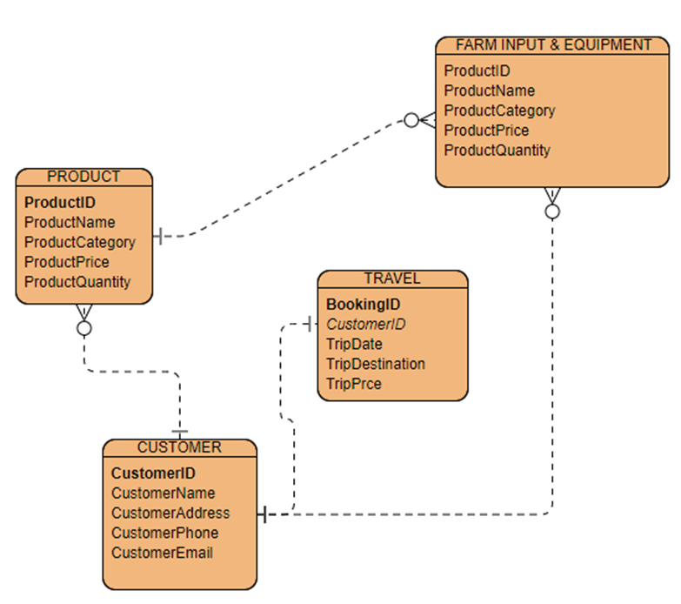

Slide 5
Normalization Process.
Normalization is a process that helps in organizing data in a relational database. It involves breaking down large tables into smaller ones and establishing relationships between them. This helps in reducing redundancy and improving data integrity.
•First Normal Form (1NF): Ensure that each column contains only atomic (indivisible) values.
•Second Normal Form (2NF): Organize data to eliminate partial dependencies. In other words, make sure that data depends on the entire primary key, not just a part of it.
•Third Normal Form (3NF): Eliminate transitive dependencies between non-key attributes.
The database will be normalized to the third normal form (3NF). 3NF is a level of data normalization that ensures that the database is efficient and that data is not duplicated.
1NF
ProductID ProductName ProductCategory ProductPrice ProductQuantity BookingID CustomerID TripDate TripDestination TripPrice ProductID ProductName ProductCategory ProductPrice ProductQuantity CustomerID CustomerName CustomerAddress CustomerPhone CustomerEmail TotalRevenue

Slide 6
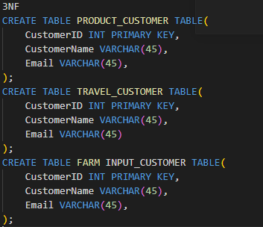
2NF
In the 2nd Normal Form, you should ensure that there are no partial dependencies on the primary key. In other words, every non-key attribute should depend on the entire primary key.
To achieve this, you might need to introduce additional tables to handle relationships and eliminate partial dependencies.
ProductID Primary Key ProductName ProductCategory ProductPrice ProductQuantity
BookingID Primary Key CustomerID Foreign Key Customer table
TripDate TripDestination TripPrice ProductID Foreign Key
Product table
ProductName ProductCategory ProductPrice ProductQuantity
CustomerID Primary Key CustomerName CustomerAddress CustomerPhone CustomerEmail TotalRevenue
3NF
In the 3rd Normal Form, you eliminate transitive dependencies. This means that non-key attributes should not depend on other non-key attributes.

Slide 7
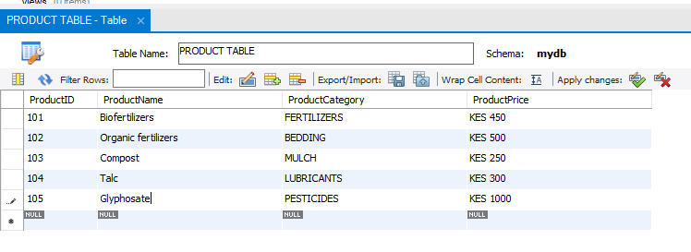
Database design schema.
The database will use a relational database schema. Relational database schemas are made up of tables, which are collections of related data.
It is widely used in various industries and provides an efficient way to store structured data.
To present the backbone of our project the SQL tables that form the foundation of our data architecture. As a team, we've meticulously designed and structured our database to capture, organize, and retrieve information seamlessly. These tables serve as the heartbeat of our project, each holding a unique piece of the puzzle. Without further delay, let's delve into the core of our data infrastructure.
First the product table:

Slide 8
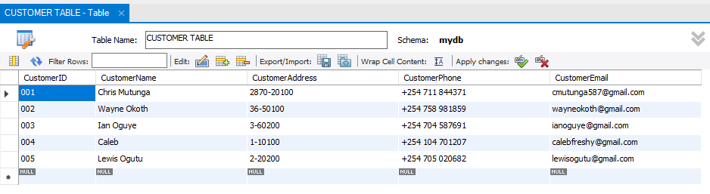
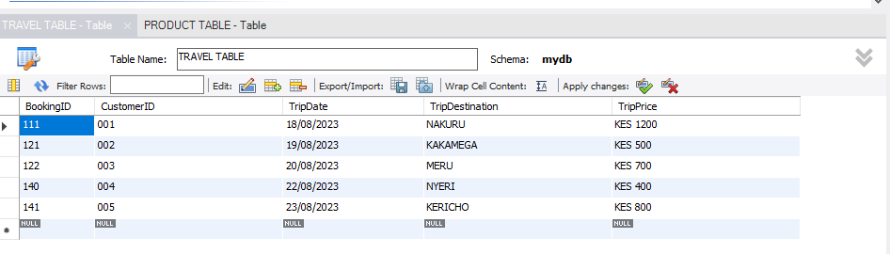
Customer table:
Travel table:

Slide 9
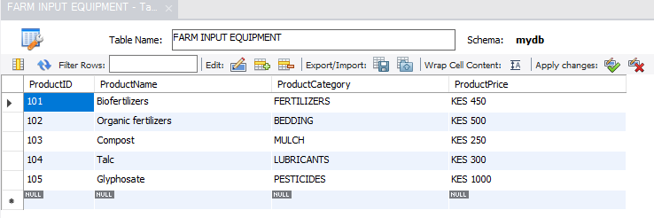
FARM INPUT TABLE:
Link to the folder is
https://github.com/GROUP-3-BSC-2107/BSC-2107-PROJECT/blob/main/SQL%20CODE.sql

